Slide 1

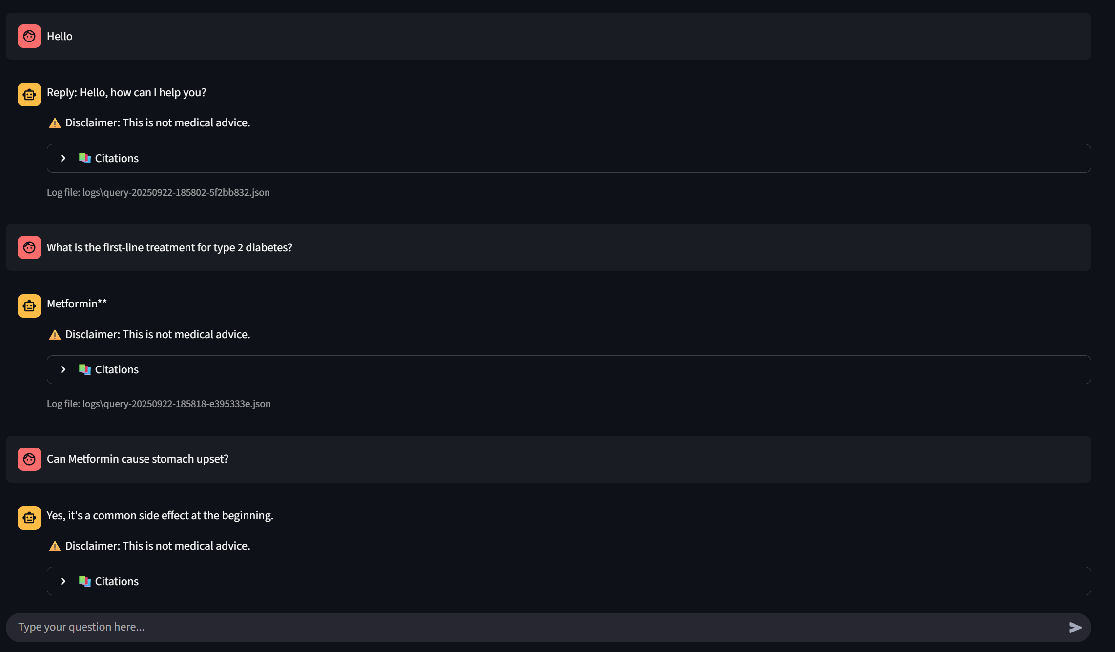
Medical RAG Assistant: Multi-Source Question Answering
Gehna Ahuja

Slide 2
Problem Statement
Patients and practitioners face fragmented medical info:
Official guidelines (trustworthy but hard to navigate)
Forums (real-world patient experiences, but noisy)
Blogs (new insights, but may conflict with guidelines)
Need a system that:
Retrieves across sources
Re-ranks for relevance
Handles contradictions safely

Slide 3
Solution - Chunking
Different sources have different structures, so we split them differently:
Docs (Clinical Guidelines) Example: “Type 2 Diabetes: First-line treatment is Metformin. Add GLP-1 agonist if HbA1c uncontrolled after 3 months.”
Split by sections (Diagnosis, Lifestyle, Medications, CKD, Obesity).
Ensures retrieval returns the right guideline snippet.
Forums (Patient Discussions) Example: Original Post (OP): “I started Metformin and I feel stomach pain, is this normal?” Reply: “Yes, it’s common in the first weeks.”
We bundle OP + top replies → keeps discussion context.
Blogs (Research Updates) Example: “GLP-1 receptor agonists like Semaglutide not only reduce HbA1c but also support weight loss.”
Split by headings and paragraphs.
Covers new drugs (SGLT2i, GLP-1, obesity trends).
👉 This ensures chunks are self-contained, but not too large.

Slide 4
Solution
Reranker (Cross-Encoder for fine relevance)
Example query: “What is the first-line treatment for Type 2 diabetes?”
Retriever may return:
Forum: “My doctor put me on insulin first.”
Doc: “Metformin is recommended first-line.”
Blog: “After Metformin, GLP-1 agonists are used.”
The TinyBERT reranker directly compares query + text and ranks doc guideline highest.
Hybrid Retrieval (BM25 + Dense embeddings + Source weights)
BM25 (keyword search): Finds exact medical terms.
Query: “Metformin stomach upset” → Matches forum posts containing those words.
Dense embeddings (semantic search): Finds meaning beyond keywords.
Query: “Why does Metformin cause GI issues?” → Matches “Metformin may cause stomach side effects”.
Source weights (trust bias):
Docs (+0.15), Blogs (+0.05), Forums (+0.0).
Example: If both a doc and a forum say something → doc is boosted.

Slide 5
Conversational Memory
New feature: multi-turn chat with memory.
Example:
Q1: “What is first-line for diabetes?”
Assistant: “Metformin is first-line unless contraindicated.”
Q2: “And if it doesn’t work?”
Assistant: “GLP-1 agonists can be added if glucose remains uncontrolled.”
👉 History is stored in session state (Streamlit chat bubbles).
Contradiction Detection (Lightweight NLI + Rules)
Example query: “Are beta blockers first line for hypertension?”
Sources:
Doc: “First-line medications: ACEi, ARBs, CCBs, thiazides.”
Forum: “My doctor started me on beta blockers first.”
A smaller NLI model (BART-MNLI) + negation rules detects contradiction.
Resolution policy: Docs > Blogs > Forums.
Both versions are logged for transparency.
Solution
Answer Generation (LLM Synthesis)
Previous version: concatenated text chunks.
Now: uses Flan-T5 (or similar) to generate fluent, natural answers.
Example: User: “What is first-line treatment for CKD with hypertension?” Answer:
“For patients with CKD and hypertension, ACE inhibitors or ARBs are recommended as first-line. If the patient also has diabetes, SGLT2 inhibitors may be added to slow kidney disease progression.”
⚠️ Always ends with disclaimer: “This is not medical advice. Please consult a healthcare provider.”

Slide 6
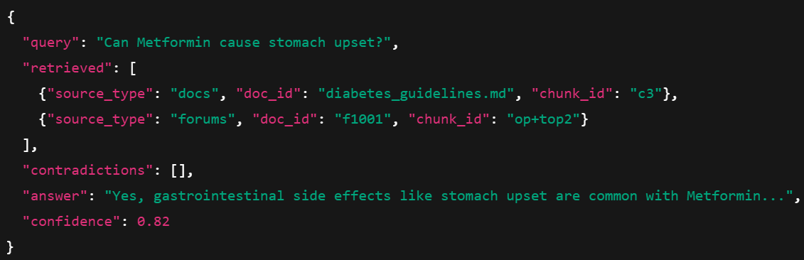
Solution
Logging (Audit trail)
For every query, a JSON log is created:
Streamlit App (Chat Interface)
Chat bubbles like ChatGPT (st.chat_message, st.chat_input).
Example query: “What new obesity treatments are available in 2025?”
Answer: “New trends in 2025 emphasize GLP-1 receptor agonists (Semaglutide, Tirzepatide), which not only help with weight loss but also reduce cardiovascular risk.”
Citations: Blog (obesity_trends.md), Doc (obesity_guidelines.md).

Slide 7
Evaluation
Tested on 15 example medical queries
Metrics:
Recall@5 ≈ 0.9
MRR@5 ≈ 0.8
Example queries:
“What is the first-line treatment for type 2 diabetes?”
“Can Metformin cause stomach upset?”
“Are beta blockers first line for hypertension?”
“What new diabetes drugs are available in 2025?”

Slide 8
Impact, Next Steps & takeaway
Impact:
Brings together trustworthy + experiential knowledge
Transparent logging → explainable healthcare AI
Next Steps:
Add conversational memory (multi-turn Q&A)
Fine-tune models on domain-specific medical corpora
Deploy securely (with access control, HIPAA-safe infra)
Takeaway:
RAG can bridge the gap between guidelines, patient experience, and research blogs
Ensures explainable, auditable, and safe answers
⚕️ “Not medical advice — but a powerful tool to guide and inform

Slide 9
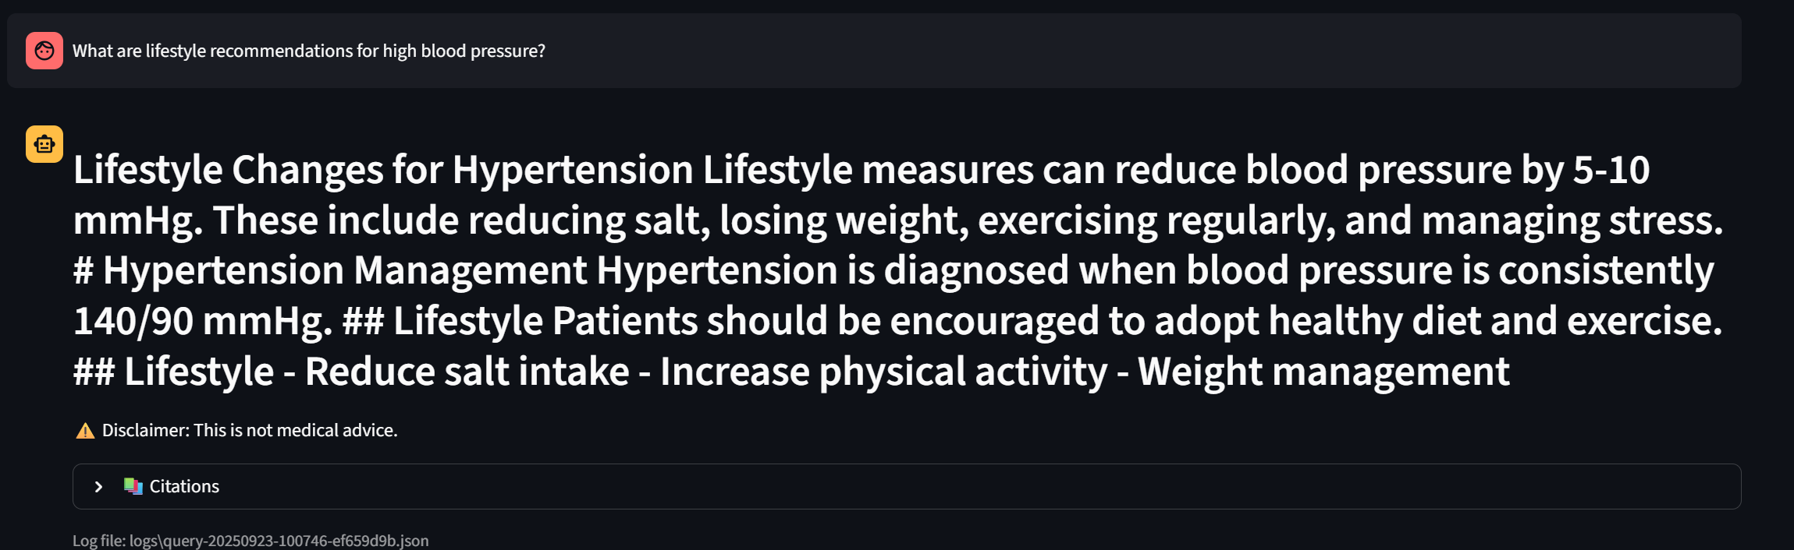
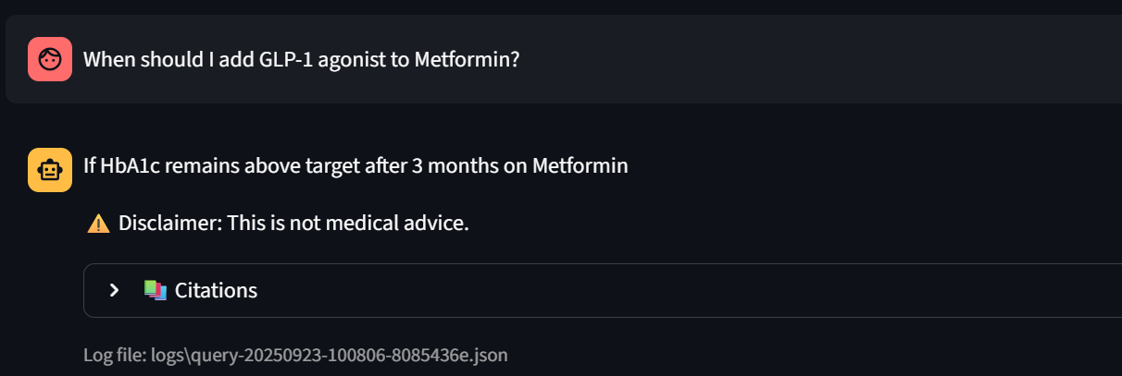
Demo

